Slide 1

Crop Prediction
Sohel Latif Tamboli.
Arbaj Kasam Shaikh
Dattatray Ramesh Pawar.
Shubham Sampat Gawade
Under Guidance Of
Prof . CHAVAN.A.A

Slide 2
Introduction
Farming is a remarkable part of the economy in India.
Parameter like pH , Nitrogen , Phosphate , Potassium, and also parameter related to atmosphere such as sunshine hours , rainfall , temperature.
Crop prediction methodology is used to predict the suitable crop by sensing various parameter of soil.

Slide 3
Problem Statement
To Design, Develop and Implement the crop prediction System

Slide 4
Objective
The main objective of our system is to give idea about achieve maximum crop yield.
Another main objective is to predict the yield of the crops using different parameters like rainfall, temperature, fertilizers, pesticides, ph level, and other atmospheric conditions and parameters.

Slide 5
Motivation
Agriculture plays a major role in increasing economy of the country. But to achieve this, farmers needs to resolve so many difficulties like crop yield prediction problems, crop loss due to floods, drought, sudden change in temperature, crop diseases infections and disease detection etc.
The main motive is to give best result of crops to farmar.

Slide 6
Literature Survey
Ananthara, M. G. Et Al. (2013, February) Proposed A Prediction Model For Datasets Pertaining To Agriculture Which Is Called As Cry Algorithm For Crop Yield Using Beehive Clustering Techniques. They Considered Parameters Namely Crop Type, Soil Type, Soil Ph Value, Humidity And Crop Sensitivity. Their Analysis Was Mainly In Paddy, Rice And Sugarcane Yields In India. Their Proposed Algorithm Was Then Compared With Cr Tree Algorithm And It Outperformed Well With An Accuracy Of 90 Percent [2]. Awan, A. M. Et Al. (2006,april) Built A New, Smart Framework Focused On Farm Yield Prediction Clustering Kernel Methodology And They Considered Parameters Like Plantation, Latitude, Temperature And Precipitation Of Rainfall In That Latitude.They Had Experimented Weighted K-means Kernel Method With Spatial Constraints For The Analysis Of Oil Palm Elds [3]. Chawla, I. Et Al. (2019, August) Used Fuzzy Logic For Crop Yield Prediction Through Statistical Time Series Models. They Considered Parameters Like Rainfall And Temperature For Prediction Their
Prediction Was Classification With Levels `Good Yield' , `Very Good Yield' [4]. Chaudhari, A. N. Et Al. (2018, August) .

Slide 7
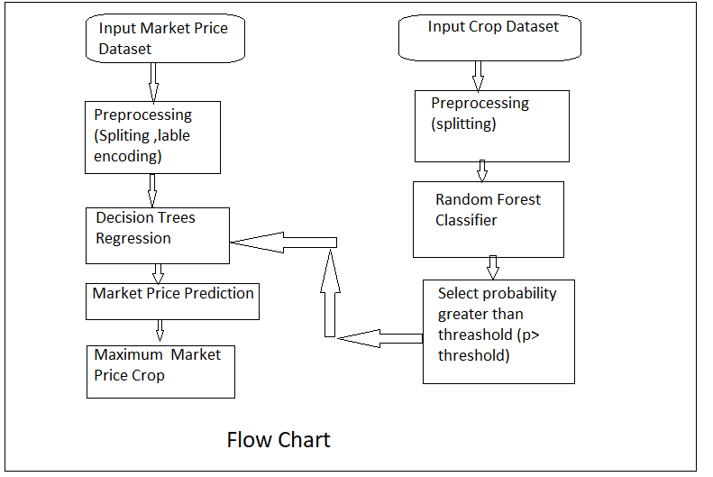
System Architecture

Slide 8
ALGORITHM
RANDOM FOREST CLASSIFIER
INPUT: CROP DATASET
OUTPUT: CROP
PSEUDO CODE:
X:INDEPENDENT FEATURES
Y:DEPENDENT FEATURES
SPLIT X,Y INTO TRAINING AND TESTING DATASET
X TRAIN,X TEST,Y TRAIN,Y TEST
RANDOM FOREST CLASSIFIER: USE MULTIPLE DECISION TREES AND TAKE MAJORITY VOTE

Slide 9
ALGORITHM
DECISION TREE REGRESSION
INPUT: MARKET DATASET
OUTPUT: MARKET SIZE OF CROP
X:Independent features
Y:Dependent Features
Split X,Y into Training and testing dataset
X_TRAIN,X _TEST,Y_TARIN,Y_TEST
DECISION TREE REGRESSION CLASSIFIER: IT CREATE DECISION TREE BASED ON MOST PROBABLE VALUE AND THEN GIVES RESULT IN LESS TIME.
END RETURN CLASS LABELS.

Slide 10
REQUIREMENT ANALYSIS
HARDWARE INTERFACES:
THERE IS NO ANY EXTERNAL HARDWARE REQUIRED ITS RUN ON ITS OWN HARDWARE AS HARD DISK,MULTICORE PROCESSOR , MINIMUM 8GB RAM
SOFTWARE INTERFACES:
PYCHARM, VISUAL STUDIO CODE,BROWSER WHICH WILL SUPPORT HTML5

Slide 11
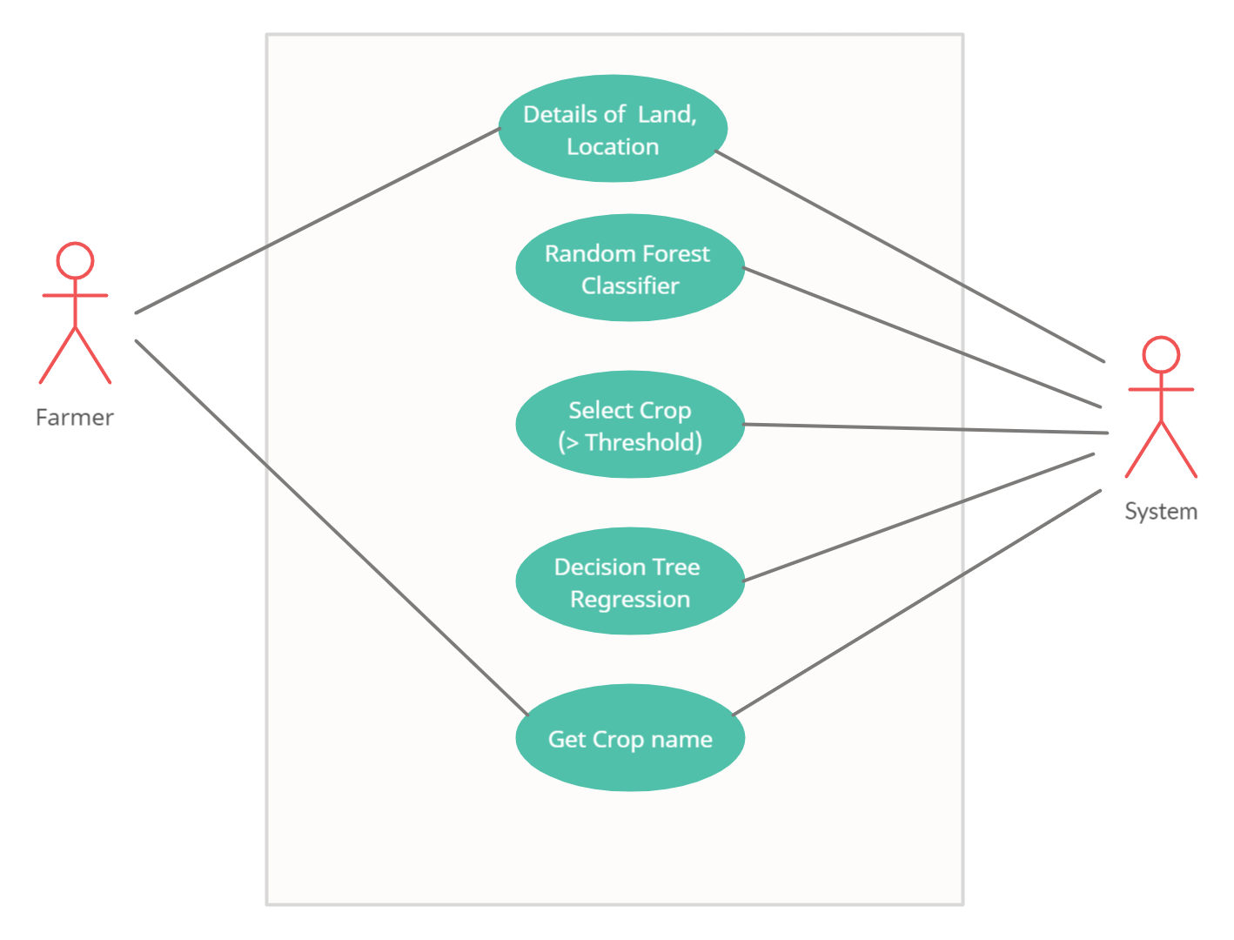
CASE DIAGRAM

Slide 12
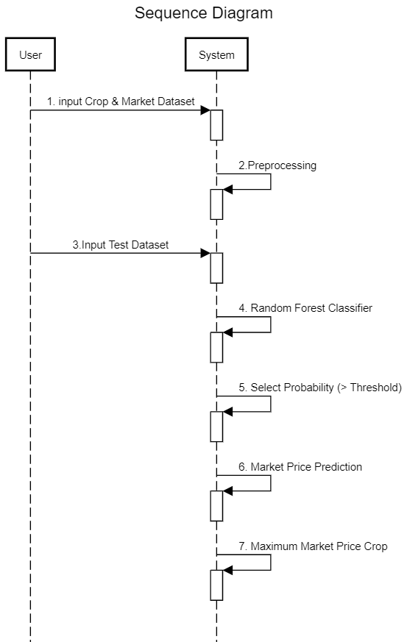
SEQUENCE DIAGRAM

Slide 13
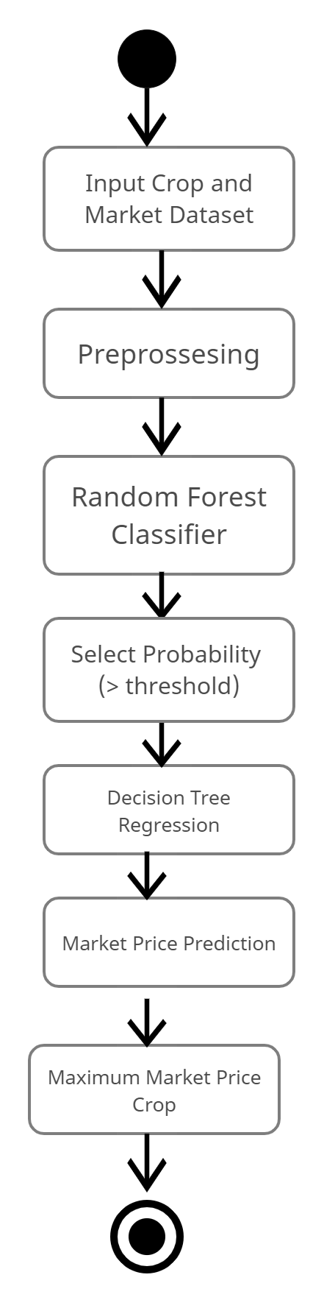
ACTIVITY DIAGRAM

Slide 14
CONCLUSION
The proposed system takes into consideration the data related to soil, weather and location
and suggests which are the best profitable crops which can be cultivated in the apropos environmental condition and Market Price.

Slide 15
References
Komal “PREDICTION OF CROP YEILDS BY USING DATA ANALYSIS” irjmets, Volume:02/Issue:06/June -2020
Potnuru Sai Nishant, Pinapa Sai Venkat, Bollu Lakshmi Avinash, B. Jabber “Crop Yield Prediction based on Indian Agriculture using Machine Learning” IEEE 2020
S.Bhanumathi worked on “Crop Yield Prediction and Efficient use of Fertilizers” IEEE 2019.
data.gov.in.” [Online]. Available: https://data.gov.in/

Slide 16
Thank YOU

